Slide 2
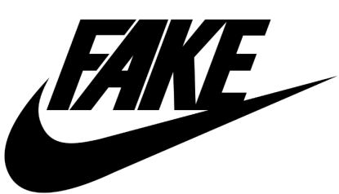
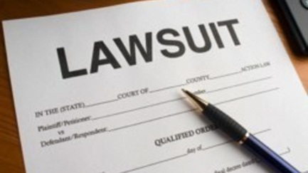
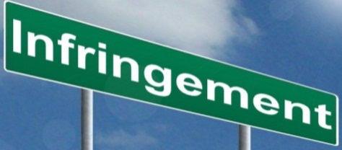

Trends in Pharmaceutical IP-Infringement
Kishor Vinchhi
Cadila Healthcare Limited

Slide 3
The Flow of Contents
Insight of Global Pharmaceutical Market
Infringement & Socio-Economic Significance
Statistics of Infringement Actions
Recent case laws

Slide 4
Global Pharmaceutical Market
An Insight

Slide 5
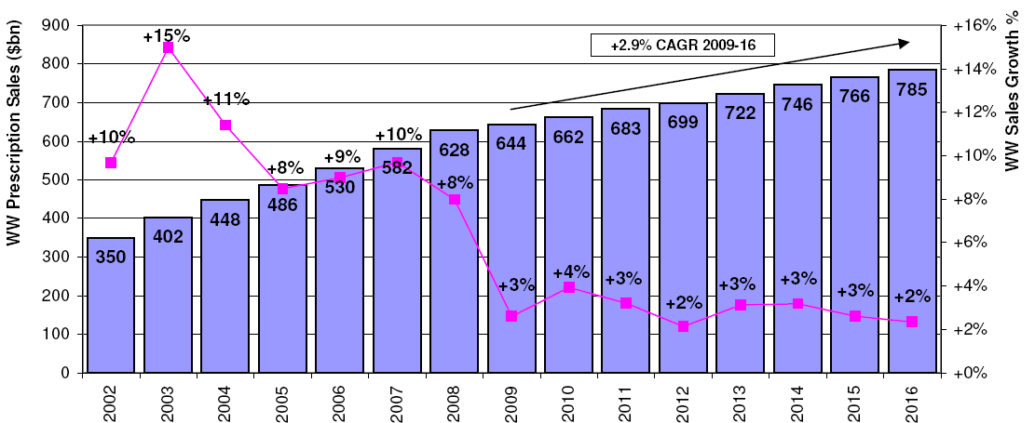
Worldwide Prescription Drug Sales (2002-16)

Slide 6
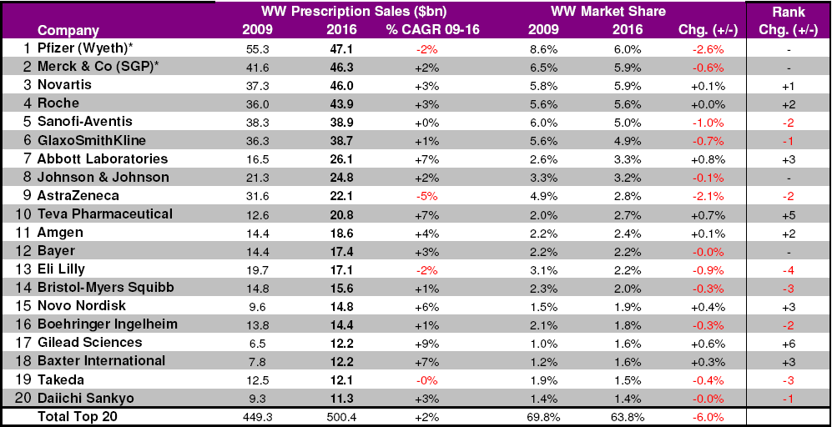
Top 20 Companies & Total Market

Slide 7
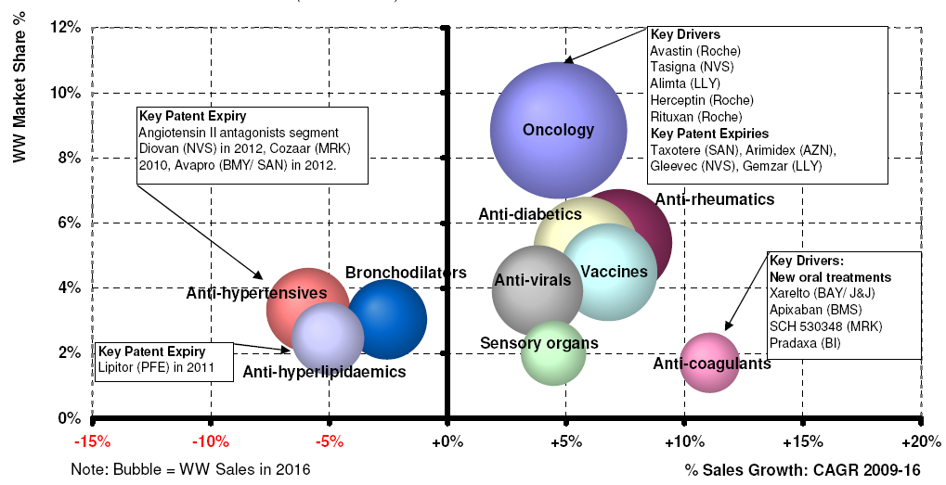
Top 10 Therapy Areas (2009-16)

Slide 8
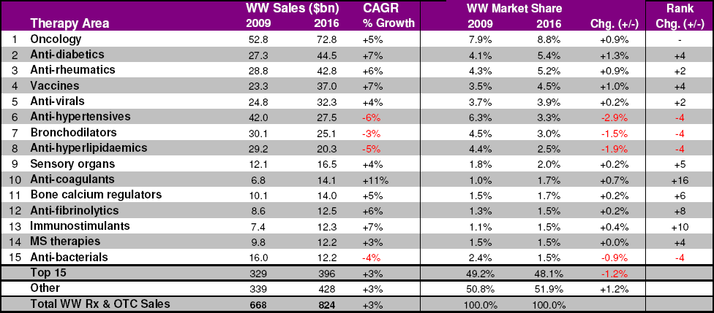
Worldwide Sales by Therapy Area (2009/16)

Slide 9
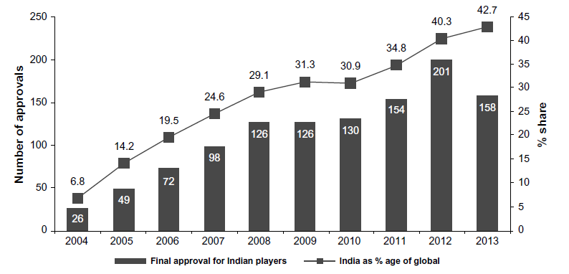
Global Presence of Indian Pharma Co.s
Trends in Abbreviated New Drug Application approvals in the USA for Indian pharmaceutical companies.
Innovation and Entrepreneurship in Health 2016:3 57–68

Slide 10
Infringement
Types of Infringement & Its Socio-economic Influence

Slide 11
Infringement
“Violating an owner’s Right”
Patent Infringement : Using or selling a patented invention, especially for commercial purposes, without permission of the (patent) owner
Likewise – Copyright and Trademark Infringements
“It is estimated that the legitimate industry loses approximately €10 billion of revenue annually due to the presence of counterfeit medicines in the EU marketplace, corresponding to 4.4% of the sector’s sales.”¹
1. THE ECONOMIC COST OF IPR INFRINGEMENT IN THE PHARMACEUTICAL INDUSTRY; September 2016; Quantification of infringement in Manufacture of pharmaceutical preparations (NACE 21.20)

Slide 12
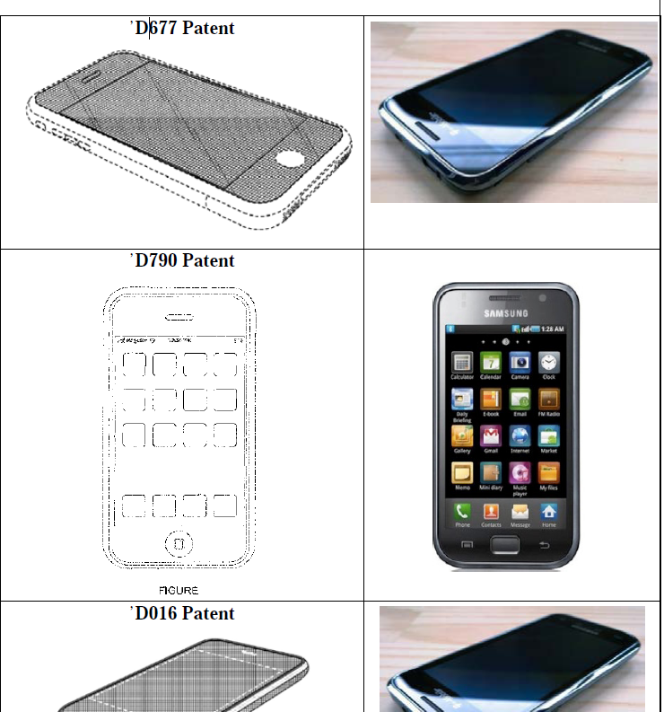
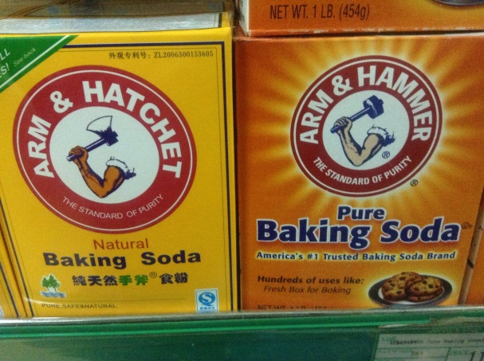
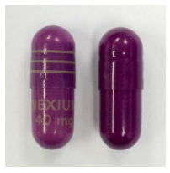
Infringement ?? !!!

Slide 13

Types of Infringement
Infringement
  Direct Infringement
  Indirect Infringement
    Contributory Infringement –
      Not actively participated but contributed to the infringement
    Induced Infringement
      Providing instructions to (induce) the end user such that to enable him/her to practice the right protected process and/or producing right protected product
Artificial Infringement ..!!!
  The ANDA litigations

Slide 14


Socio-Economic Implications
Proved Guilty of infringement –
  Pay high amount of damages & litigation cost
Successfully proved the defendant infringing
  Get paid for in term of damages due to loss of profit and others
Enforcement
  Willful infringement is a social and economic menace and prejudice to sanctity of law
  Unfair to market competitiveness
  enforceability of the IPRs encourage innovation and development

Slide 15
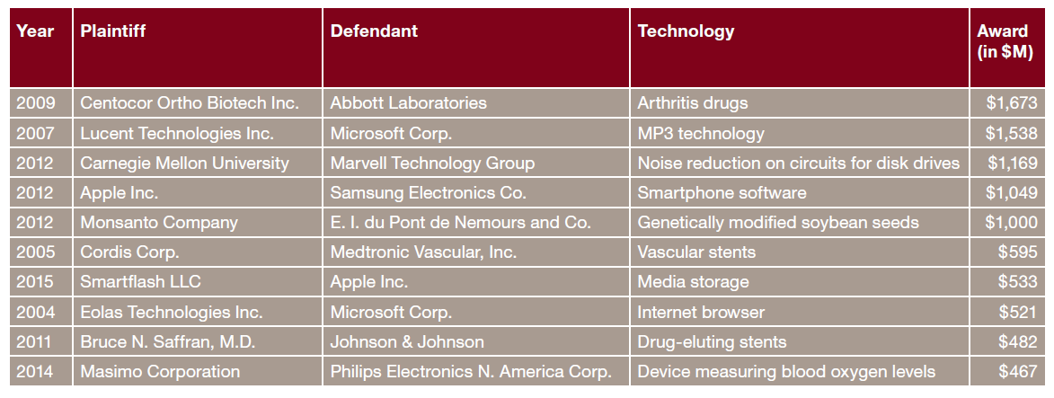
Guilty of Infringement ??? Damages
Top ten largest initial adjudicated damages awards: 1996 –2015
Chris Barry et. al. 2016 Patent Litigation Study: Are we at an inflection point? www.pwc.com/us/forensics

Slide 16
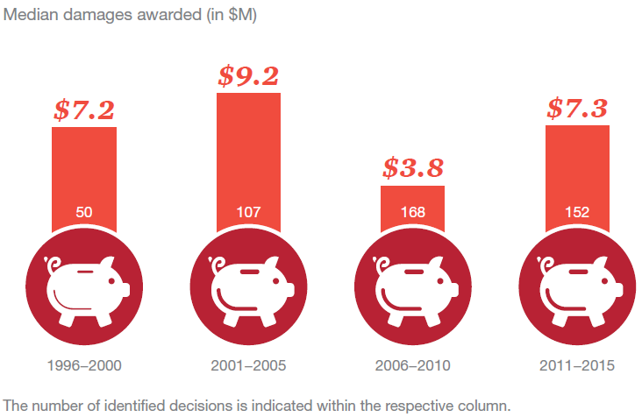
Guilty of Infringement ??? - Damages
Median damages awarded : Adjusting for inflation using the consumer price index (CPI), the annual median damages award over the years 1996 through 2015)
Chris Barry et. al. 2016 Patent Litigation Study: Are we at an inflection point? www.pwc.com/us/forensics

Slide 17
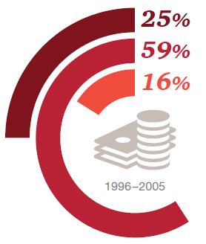
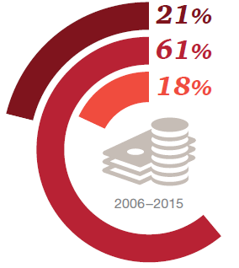
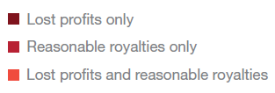
Compensation to Patent Holder
Patent holders are generally compensated for infringement in two broad ways
  Reasonable royalties
  Loss of Profit (Triple damages in US)
  (Sometimes both..!!!)
Composition of damages awards
Chris Barry et. al. 2016 Patent Litigation Study: Are we at an inflection point? www.pwc.com/us/forensics

Slide 18
infringement
Statistics

Slide 19
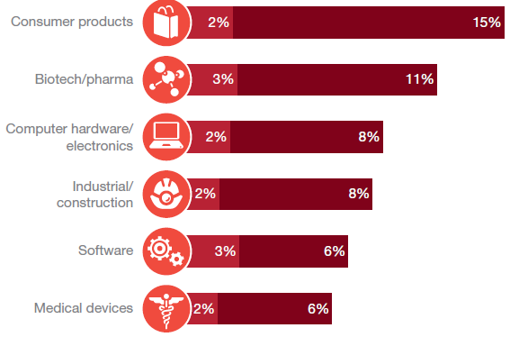

Dominance of Pharmaceuticals
2nd in terms of number of Patent Infringement-Litigations Filed
Chris Barry et. al. 2016 Patent Litigation Study: Are we at an inflection point? www.pwc.com/us/forensics

Slide 20
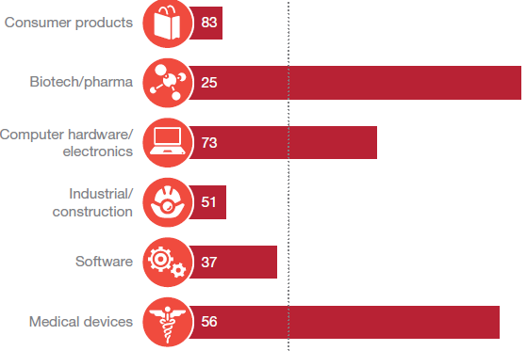
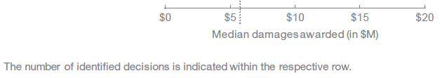
Dominance of Pharmaceuticals
1st in terms of Damages Awarded
Chris Barry et. al. 2016 Patent Litigation Study: Are we at an inflection point? www.pwc.com/us/forensics

Slide 21
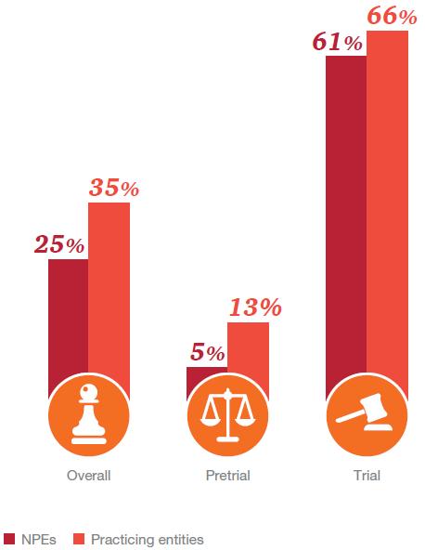
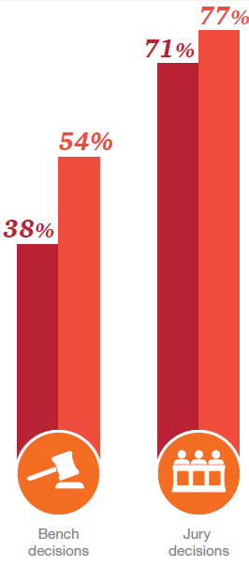
Success Rates for Patent Holders
Overall Success Rate Success Rate at Trials
Chris Barry et. al. 2016 Patent Litigation Study: Are we at an inflection point? www.pwc.com/us/forensics

Slide 22
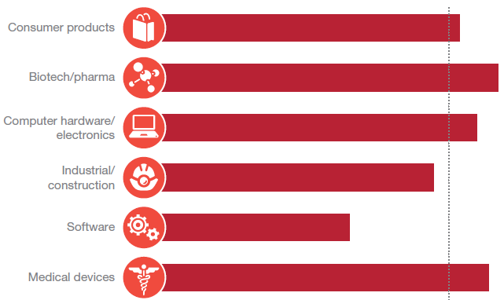
Success Rates for Patent Holders
Success Rate for Pharmaceuticals is above the Overall Average
Chris Barry et. al. 2016 Patent Litigation Study: Are we at an inflection point? www.pwc.com/us/forensics

Slide 23
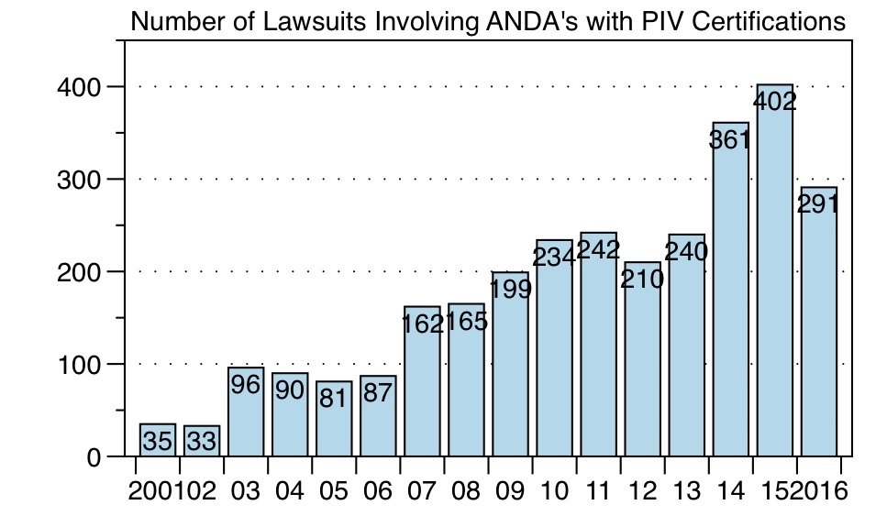
ANDA Litigations
Source: Paragraph IV

Slide 24
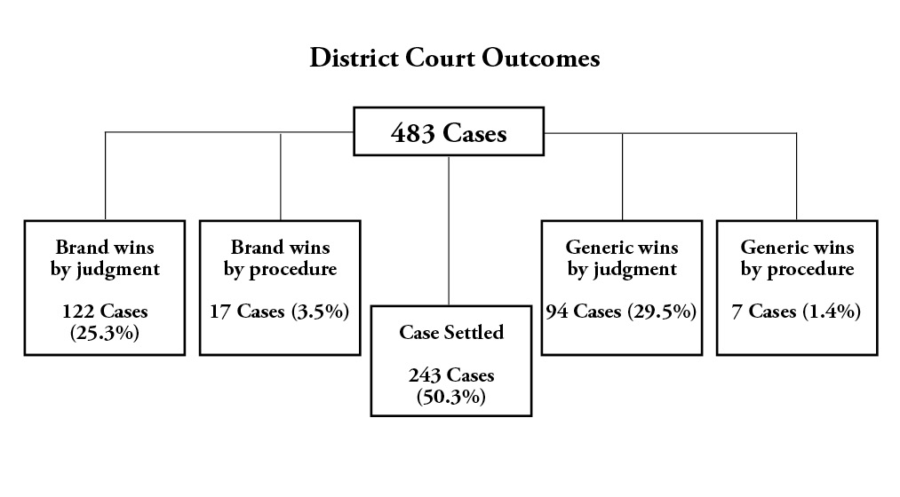
ANDAs Court case: Statistics 2016

Slide 25
Case laws
Recent

Slide 26
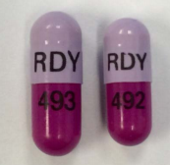
Astrazeneca vs. Dr. Reddys’ – Nexium
‘The Purple Pill’
Astrazeneca and Dr. Reddy’s settled their Hatch-Waxman case in 2011. As part of that settlement, Dr. Reddy’s was enjoined from selling generic Nexium® until 2014, and it did not begin distributing its generic version until September 25, 2015.
Astrazeneca later restrained Dr. Reddy’s from selling a generic pill that is purple, just like Nexium®.
Astrazeneca had been selling purple pills, both Nexium® and Prilosec®, since 1989. It had three trademarks specifically covering gastrointestinal pharmaceuticals, and one specifically directed to “The PURPLE PILL®” for the same drugs.
The generic versions of Nexium® sold by Teva and Mylan used blue and white capsules while Dr. Reddy’s specifically sold purple capsules [Pic-1, Right side]
DRL sued AZ for breach of settlement agreement and later in January-16, changed the colour to blue to resume US sales while the litigation continues [Pic-2]
http://www.in-pharmatechnologist.com/Processing/AZ-retains-purple-reign-Dr-Reddy-s-relaunches-Nexium-generic-in-blue

Slide 27
Merck V. Gilead - Sofosbuvir
Gilead launched Sofosbuvir (SOVALDI) - originally developed by Pharmasset, which Gilead bought in 2011.
Global sales: 25326M USD
Idenix filed lawsuit against Gilead citing Sofosbuvir infringed Idenix patent of a hepatitis C treatment that had been developed years earlier – Idenix later acquired by Merck
The District court found the patent valid and infringing & awarded Merck $200 million in damages
The FC however overturned the verdict citing ‘misconduct’ on Merck side
The federal Jury in Dec-16 reversed the FC decision and ordered Gilead to pay $2.54 billion to Merck in Royalties

Slide 28
Momenta V. Teva / Momenta v. Amphastar - Enoxaparin
Momenta sued Teva and Amphastar under 35 USC §271(a) (Amphastar) and under 35 USC § 271(g) (Teva and Amphastar) for allegedly infringing its patented process for testing batches of the anticoagulant drug enoxaparin for compliance with U.S. quality requirements.
Teva imported enoxaparin and used the testing method in Italy to sort for batches of sufficient quality to enter the U.S. market.
Amphastar manufactured enoxaparin within the U.S., and used the test as intermediate and final steps to sort its batches.
The district court granted summary judgment in favor of Teva and Amphastar, holding that
  their activities fell within safe harbor provisions of 35 USC §271(e)(1) by being performed "solely for uses reasonably related to the development and submission of required information under Federal law," and
  neither defendant infringed under 35 USC §271(g) because neither imported a product that was "made by" a process patented in the U.S.

Slide 29
Momenta V. Teva / Momenta v. Amphastar - Enoxaparin
In December 2015, Federal Circuit affirmed the district court's summary judgment granting of non-infringement under §271(g) because neither Teva nor Amphastar made enoxaparin by the patented process.
Because alleged infringement under §271(g) was the only issue regarding Teva, and summary judgment of non-infringement had been affirmed, the district court's holding regarding safe harbor provisions was moot with respect to Teva.
With respect to non-infringement of Amphastar’s activity under safe harbor provisions, Federal Circuit reversed district court’s summary judgment and held that the safe-harbor provision was inapplicable, because use of the testing process was not for developing and submitting required information under Federal law.
In May 2016, Amphastar filed a petition for certiorari, presenting the question: “Whether the safe harbor protects a generic drug manufacturer’s bioequivalence testing that is performed only as a condition of maintaining FDA approval and is documented in records that must be submitted to the FDA upon request.”
In October 2016, the United States Supreme Court denied Amphastar petition for certiorari.

Slide 30
Bayer V. Glenmark - Azelaic acid Gel
Bayer holds an approved NDA for Finacea gel (the RLD), which is a topical drug formulation containing azelaic acid.
The dispute was related to Orange Book listed U.S. Patent No. 6,534,070 covering the composition of the RLD. The patent claims a hydrogel formulation of Azelaic acid including the substances triglyceride and lecithin.
Glenmark designed its own gel using isopropyl myristate as a skin penetration enhancer and leaving out triglyceride and lecithin.
Bayer filed its infringement lawsuit under DOE theory stating that triglyceride and lecithin performed the same penetration-enhancing functions as Glenmark’s use of isopropyl myristate.
The district court of Delaware held that the US ‘070 patent was valid and applying function-way-result test it held that the Glenmark’s formulation infringed the patent under doctrine of equivalents.

Slide 31
Bayer V. Glenmark - Azelaic acid Gel
The district court under function-way-result test determined that
  the excipient isopropyl myristate in Glenmark’s formulation performs the same function as the claimed excipients, triglycerides and lecithin – namely, enhancing azelaic acid’s penetration of the skin; (based on Glenmark’s ANDA which repeatedly stated that lecithin and triacylglyceride, and the replacement ingredient, isopropyl myristate, all enhance skin penetration).
  in substantially the same way as the claimed excipients – by disrupting the lipids in the skin’s outermost layer, stratum corneum (based on expert testimony and scientific literature);
  obtained substantially the same result – namely, a therapeutically effective azelaic acid composition able to penetrate the skin to deliver the active ingredient
Federal Circuit affirmed the finding of infringement under the DOE .
Take away – Non-infringement positions/arguments should be in alignment with the submissions made to the FDA during the approval of the generic formulation/product.

Slide 32
Vanda V. Roxane - Iloperidone
Vanda holds an approved NDA for Fanapt® (iloperidone Tablets).
The dispute was related to Orange Book listed U.S. Patent No. 8,586,610 along with Orange Book listed patents.
The ’610 patent claims method of treating patients suffering with schizophrenia using iloperidone wherein the method requires performing genotyping assays to identify poor metabolizer of iloperidone, and lowering patient’s dose accordingly.
Vanda filed its infringement lawsuit stating that Roxane’s proposed ANDA product would induce infringement of the ’610 patent.
Roxane’s argument with respect to non-infringement of ’610 patent was that no physician would perform both the genotyping steps and the dosing step. So, there is no direct infringement by the physician and no induce infringement by Roxane.

Slide 33
Vanda V. Roxane - Iloperidone
Vanda presented testimony and medical records of one physician who performed both steps.
District court found that there would be direct infringement by physician.
With respect to induced infringement the court concluded that Roxane’s proposed label induced infringement of the ’610 patent, because while there may be possibility that some physicians administered the drug without performing the genotyping step, the label still recommended that type of testing, and that the label was thus supporting the intent to induce.
Roxane has filed an appeal challenging the decision in Sep 2016.

Slide 34

Thank You

